Slide 1
Synchformer:
Efficient Synchronization from Sparse Cues
Vladimir Iashin
Weidi Xie
Esa Rahtu
Andrew Zisserman
University of Oxford
Shanghai Jiao Tong University
University of Oxford
Tampere University
University of Oxford
robots.ox.ac.uk/~vgg/research/synchformer/

Slide 2
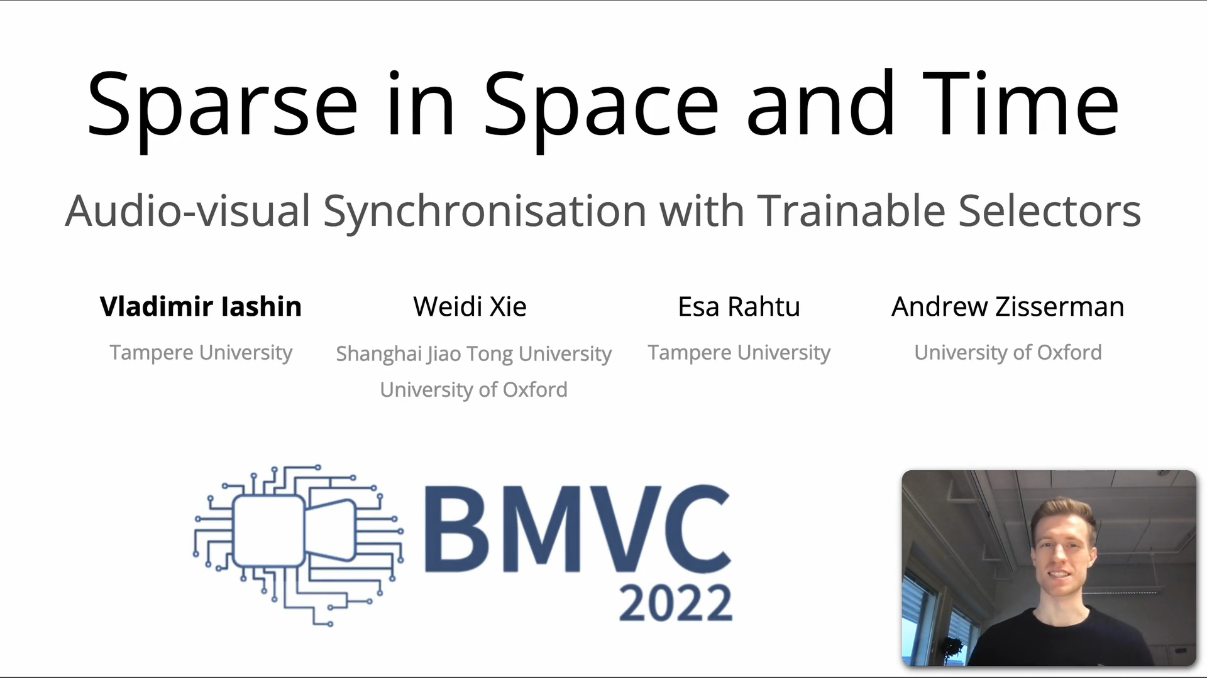
Click the frame above to play the video (with sound!)

Slide 3


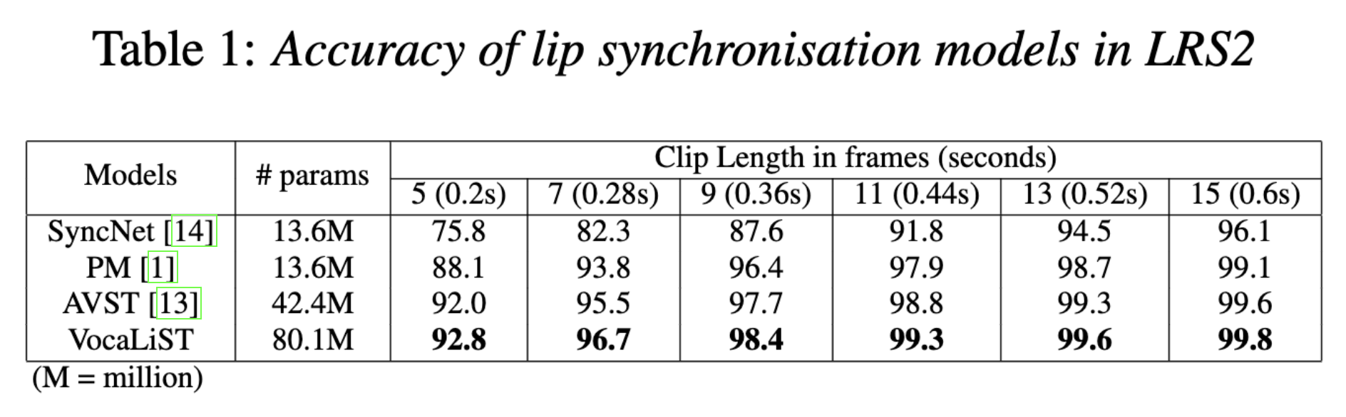
Dense vs. Sparse synchronization signals
Dense
Sparse
Easy
Hard

Slide 4


Working with sparse signals is challenging
Longer clips to catch rare cues
High resolution in space and time
High capacity to handle variety of classes

Slide 5
Prior works*
Focused on dense signals (speech; music instrument performance)
Inputs are <1 second
Shallow and low-capacity feature extractors
Outputs are binary (in-sync/out-of-sync)
(*) Chen et al. Audio-visual synchronisation in the wild. In BMVC 2021;
Kadandale et al. VocaLiST: An Audio-Visual Synchronisation Model for Lips and Voices. In Interspeech 2022; (the Table as well)
Gupta et al. ModEFormer: Modality-Preserving Embedding for Audio-Video Synchronization using Transformers. In ICASSP 2023

Slide 6
Our work
Focus on sparse videos
Inputs are >4 seconds
No compromise on capacity of feature extractors
Predicts the exact offset
Synchformer

Slide 7
Synchformer

Slide 8
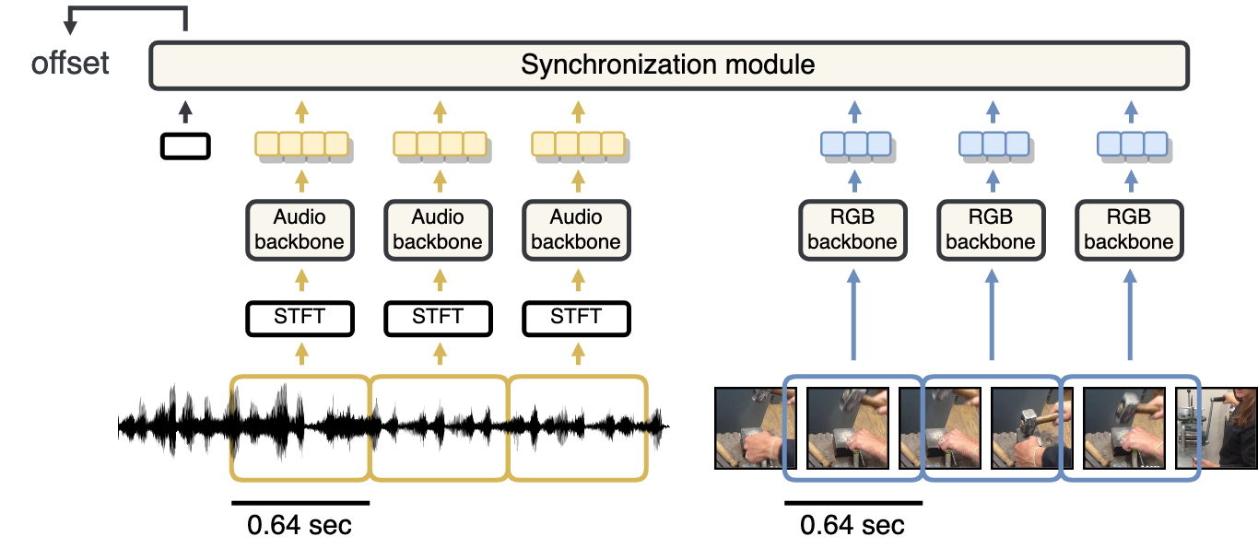
Synchformer

Slide 9
Synchformer

Slide 10
Synchformer

Slide 11
Synchformer

Slide 12
Synchformer

Slide 13
Synchformer

Slide 14
Synchformer
Transformers
(SotA but very compute-intensive)

Slide 15

Synchformer during training
Feature extractors’ weights are not updated (❄️)
Only Synchronization module is trained (🔥)

Slide 16
How to pre-training strong feature extractors?

Slide 17
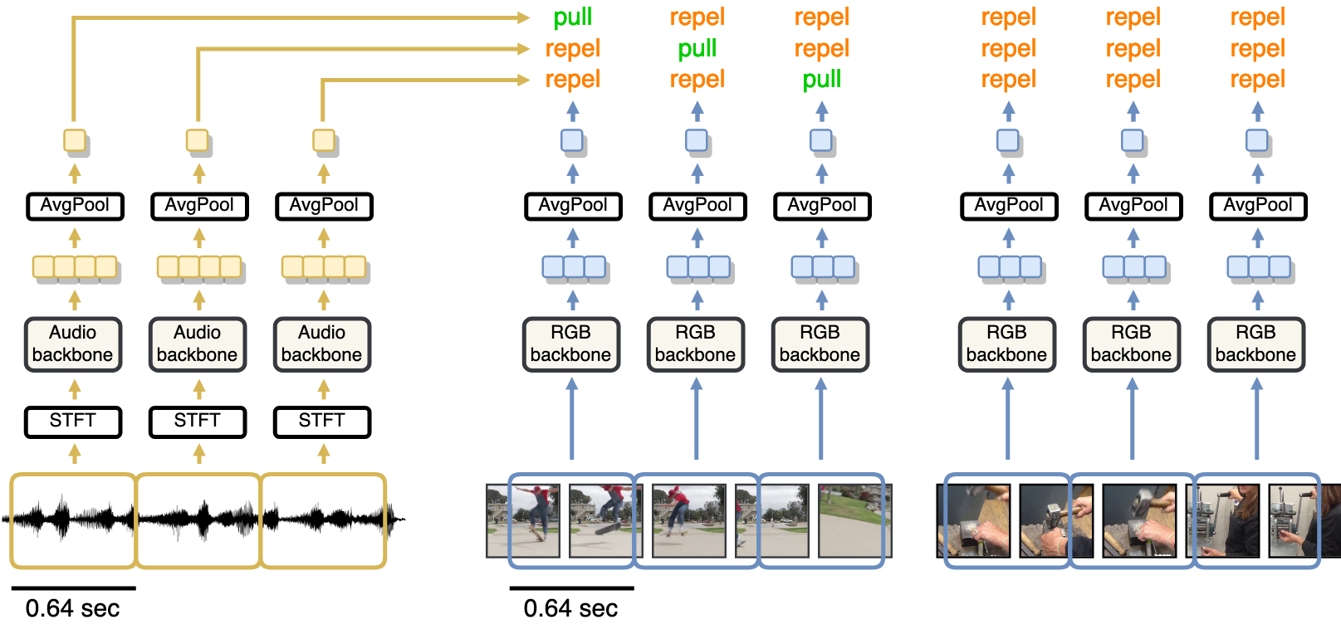
How to pre-training strong feature extractors?

Slide 18
How to pre-training strong feature extractors?

Slide 19
How to pre-training strong feature extractors?
Like OpenAI CLIP

Slide 20
How to pre-training strong feature extractors?

Slide 21
How to pre-training strong feature extractors?
Another video

Slide 22
Now train light-weight synchronization module
Feature extractors’ weights are not updated (❄️)
Only Synchronization module is trained (🔥)

Slide 23
A bit more about the experiment setting
Videos are naturally synchronized 👉 free annotation
Inputs are ~5 seconds
Inputs are offset ‘on the fly’
Training for synchronization is a classification problem
Offsets grid: [–2.0, –1.8, …, 0.0, …, +1.8, +2.0] — 21 classes
Datasets
Dense setting dataset: LRS3 (TED)
Sparse setting dataset: VGGSound, AudioSet

Slide 24
Qualitative Results

Slide 25
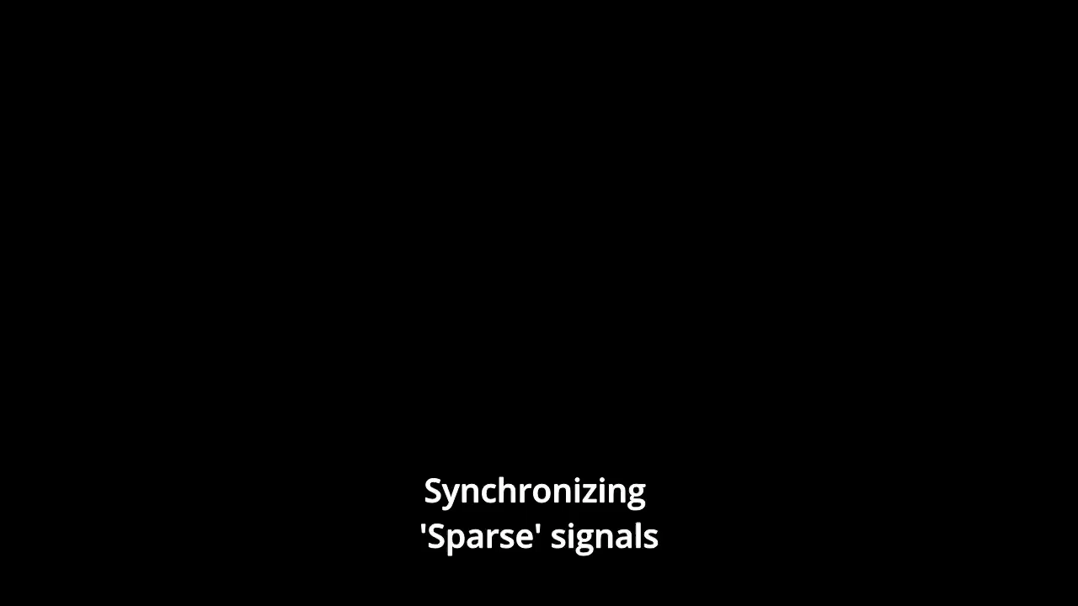
Click the frame above to play the video (with sound!)

Slide 26
State-of-the-art synchronization results
 | LRS3 (Dense signals) | VGGSound-Sparse (Sparse signals)
AVST [1] | 48.6 | 16.6
SparseSync [2] | 80.8 | 43.4
Synchformer (Ours) | 86.5 (+5.8 %p) | 54.6 (+11.2 %p)
The metric is Accuracy across 21 classes;
[1] Chen, et al. “Audio-visual synchronisation in the wild." BMVC 21;
[2] Iashin, et al. “Sparse in space and time: Audio-visual synchronisation with trainable selectors.” BMVC 22;

Slide 27
The problem of
Synchronizability

Slide 28

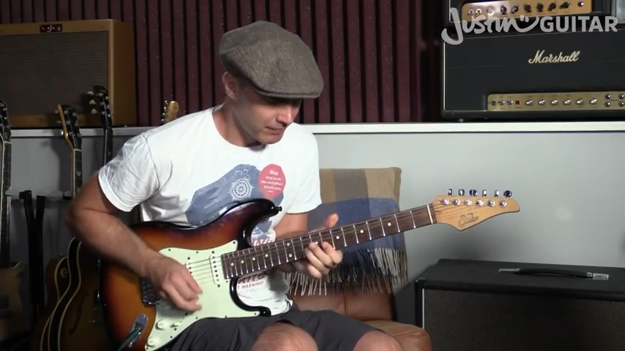
Can you tell if a video is synchronizable?
Play the videos (with sound!)
RGB Track
RGB Track
Audio Track
Audio Track
Time
Time

Slide 29
Training for Synchronizability
RGB Track
RGB Track
Audio Track
Audio Track
Time
Time
“Synchronizable”
Not “Synchronizable”

Slide 30
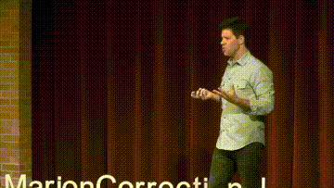
Synchronizability Results
98 %
Dense signals
72 %
Sparse signals

Slide 31
Directions for future research
High-quality open-domain video dataset
Strong audio-visual correspondence
Wide diversity of classes
Localizing sounding objects in inputs (aka. evidence attribution)
Identifying non-synchronizable events even if tracks overlap temporally

Slide 32
Synchformer:
Efficient Synchronization from Sparse Cues
Vladimir Iashin
Weidi Xie
Esa Rahtu
Andrew Zisserman
University of Oxford
Shanghai Jiao Tong University
University of Oxford
Tampere University
University of Oxford
robots.ox.ac.uk/~vgg/research/synchformer/

